Slide 1
Product review system
By 31302, 31318

Slide 2
Need for this topic
Product reviews are powerful because they convey trust – a key element to long-term loyalty. If another person was willing to spend their hard-earned money on your product (and was loyal enough to write a review), the potential buyer will be more likely to trust you as well.
Product reviews can also help you streamline the business. It gives stores an idea of which product to stock up on thus increasing their sales and boosting their business.
They also help manufacturers to better understand their customer requirements and implement right changes in future versions of their products.

Slide 3
Functionality
User can create a product review of desired category after registering.
User can refer to an existing review of a product.
User can view latest reviewed products as well as view top picks from each category.
Reviews for each product can be drawn into a chart to see its popularity over time.

Slide 4
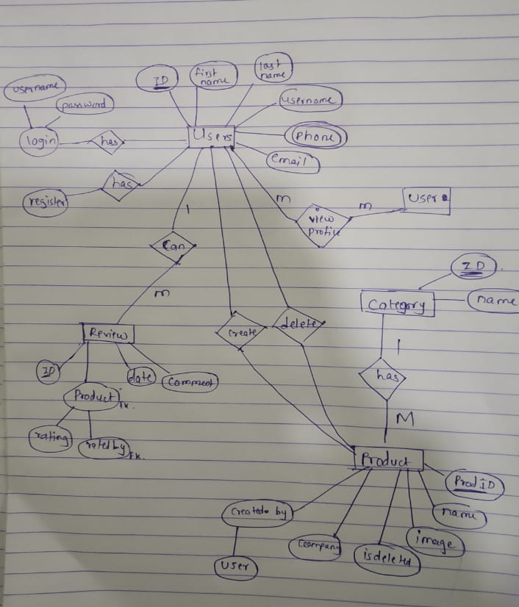
ER Diagram

Slide 5
Technology stack
Front-end : HTML CSS JavaScript
Backend : django
Database : MySQL
External libraries: Chart.js

Slide 6
Future scope
Web scraping can used to fetch the live data from websites.
Different recommendation algorithms can be used to provide personal recommendation for the users.

Slide 7
Thank you

